Slide 1
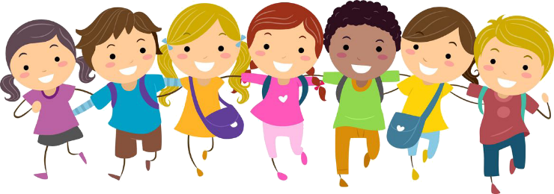
Day 2
David fights Goliath.
1 Samuel 17:1-58
Something to read:
David’s brothers were in Saul’s army. One day, David’s father sent him to visit his brothers. David saw the army getting ready to fight the Philistines. Suddenly, a giant Philistine came out. Saul’s army was afraid. They ran back to their tents. Goliath, the Philistine giant, was more than nine feet tall. Goliath yelled, “Choose a man to fight me. If he is able to kill me, we will become your slaves. But if I win the fight, you will become our slaves.” No one in the Israelite camp wanted to fight Goliath. They didn’t think anyone could beat someone so big! David knew that God was stronger than Goliath. David said, “I’ll go and fight him.” King Saul heard what David said. “You’re too young and small to fight Goliath, ” King Saul said. “But God helped me fight lions and bears when I took care of my father’s sheep, and God will help me now, ” David answered. Goliath laughed when he saw David. He even made fun of God! David used just his slingshot and a stone to fight Goliath. God helped David save his people from the Philistine army
Something to colour:

Slide 2
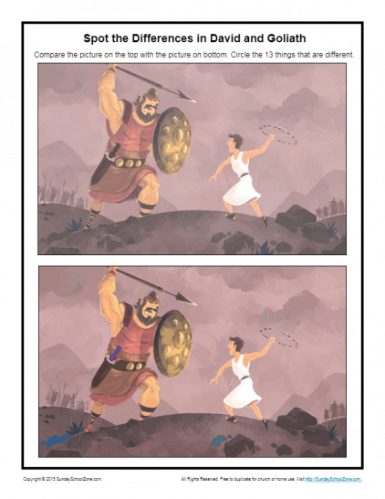
Something to watch:
Join the Superbook Characters and watch the story of David and the Giant, Goliath (27 minutes long)
https://www.youtube.com/watch?v=jdMq3YAfmO0
Some puzzles for you:

Slide 3
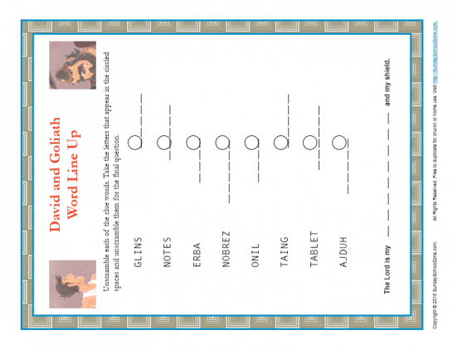
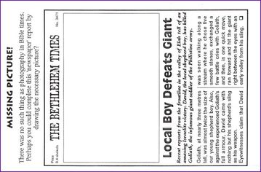

Slide 4
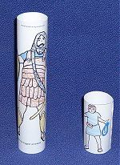
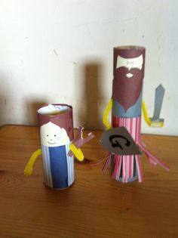
Something to make:
Needed: a kitchen roll cardboard tube,
a toilet roll cardboard tube, paper,
pens and glue
Draw a picture of Goliath, the giant and
wrap it around the large tube – glue it
Draw a picture of David, the shepherd
boy and wrap it around the smaller tube
glue it
You could use these as puppets to tell
the story of David and Goliath
If you are feeling creative, here is
Another idea for making the David
And Goliath

