Slide 1
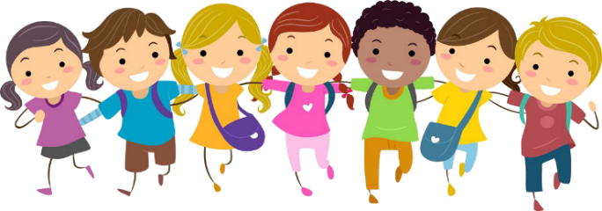
Day 5
The walls of Jericho fall down.
Joshua 6:1-27
Something to read:
Joshua and the Israelites were camped outside Jericho. The people of Jericho closed the gates to the city and didn’t let anyone in or out. They were afraid. They didn’t want the Israelites to take over their city. God told Joshua a plan to take over the city. Joshua and the Israelites did just what God said. Very quietly, they stood in a line. They didn’t say a word. They marched all the way around Jericho. They did this every day for almost a whole week. On the last day, they marched around the city one, two, three, four, five, six, seven times. Then they stopped. The priests blew the trumpets and all the people shouted. Then the walls fell down flat! The Israelites marched straight into the city
Something to colour:

Slide 2
Something to watch:
Join the characters of Superbook and watch the story of Joshua and the walls of Jericho falling down
https://www.youtube.com/watch?v=F7sm4tSS7IE
Something to sing:
Sing a long with the Superbook team as they tell the story
https://www.youtube.com/watch?v=wfPOHQOc3uI
Some puzzles for you to do:

Slide 3
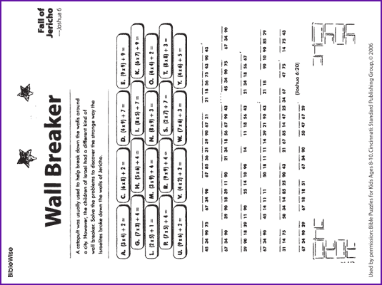

Slide 4
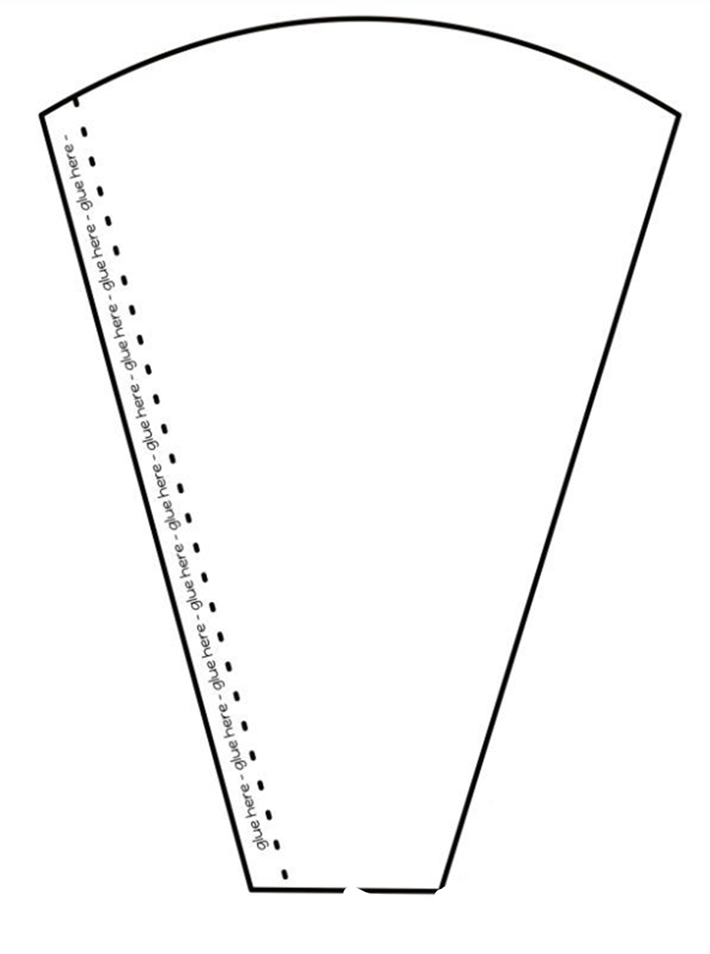
Make a horn:
Decorate the cone shape below, cut out and glue along the edge as shown.
You can now blow into the end of the horn just like they did as they marched
Around Jericho.

Slide 5
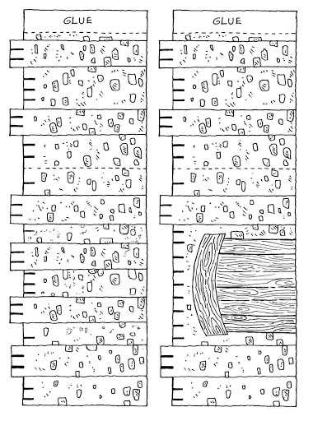
Colour in, cut out and make your own walls of Jericho. Tell the story

