Slide 1
Day 3
God protects baby Moses.
Exodus 2:1-10
Something to read:
Pharaoh was afraid of the Israelites. There were many Israelites in Egypt. Pharaoh thought there were too many Israelites. Pharaoh planned to stop them by hurting all the Israelite baby boys. But one mother hid her baby boy from the Egyptian soldiers. When she couldn’t hide him anymore, she made a basket that would float. She put the baby in the basket and carefully put it on the river. The baby’s big sister, Miriam, hid nearby to watch what would happen. Pharaoh’s daughter came to the river with her servants to take a bath. The princess saw the basket and sent one of her servants to get it. When she opened the basket, the baby was crying. The Princess felt sorry for him. Miriam ran up to the princess and said, “Shall I go and get someone to take care of this baby for you?” The princess said yes. So Miriam brought her mother to the princess. The princess told the mother to take care of the baby. Later the princess named the baby Moses. When Moses grew up, he lived with the princess, right in the Pharaoh’s palace!
Something to colour:

Slide 2
Some puzzles for you…..

Slide 3
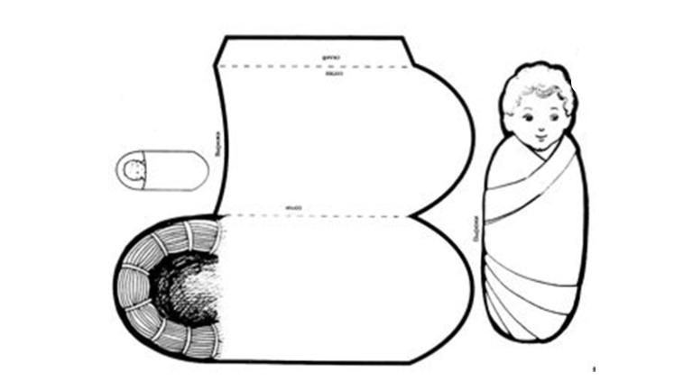
Something to Watch:
a short film of the story of the birth of Moses:
https://www.youtube.com/watch?v=vf-4x4iefQE
Some things to make:
a baby Moses sleeping in the basket.
Colour the basket and the baby.
Cut both out
Put the baby into the basket and cover him over with the blanket (flap)
You could add some bulrushes and grasses to the outside of the basket
& use the props to tell the story yourself.

Slide 4
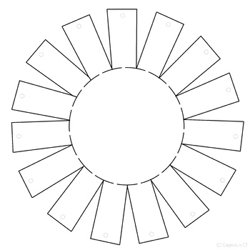
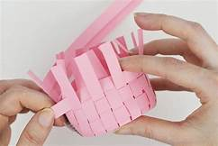
Make a paper weave basket:
You will need strips of coloured paper and the template below cut out.
Fold along the dotted lines of the template so that the tabs stick up.
Weave the paper strips in and out of the template making sure you glue
the strip at one end before you start and then glue the other end once
you have woven the strip around the shape.
For the next paper strip, if the first strip went under the tab, this time
put it over the tab

