Slide 1

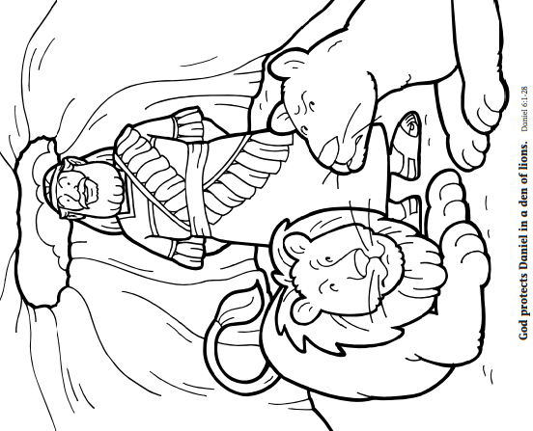

Day 4
God protects Daniel in a den of lions.
Daniel 6:1-28
Something to read:
Daniel loved God and prayed to Him every day. In fact, he prayed three times every day. Daniel knew that praying to God was a right thing to do. There were some mean men who did not like Daniel. They went to the king and said, “King, we think you should make a rule that everyone must pray only to you. If people pray to anyone else but you, they will be thrown into a cave filled with lions!” The king thought this was a good idea. The next day Daniel prayed to God. The mean men watched as Daniel prayed to God. Then they ran to tell the king what they saw. The king was sad. Daniel was his friend. The king knew he had been tricked into hurting Daniel. But the king had to obey the rule, too. Daniel was put into a big cave where hungry lions lived. All night the king worried about Daniel. The next morning, the king ran to the lions’ cave. He called, “Daniel! Daniel!” Daniel called out, “King, I am safe. The Lord God took care of me!” The king was so glad that Daniel was not hurt. Then the king told everyone what God had done.
Something to colour:

Slide 2
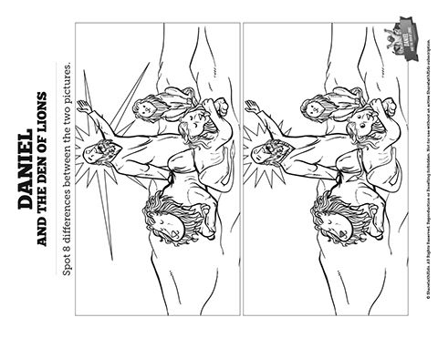
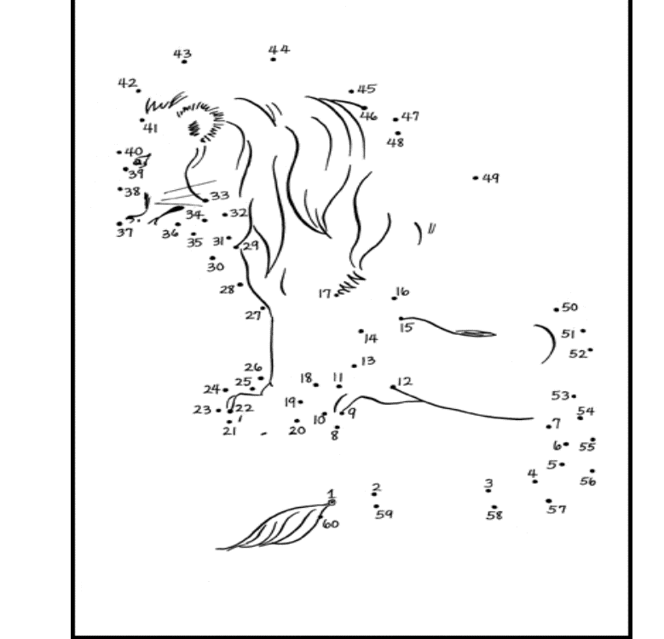
Some puzzles for you:
Join the dots to see what the picture is

Slide 3

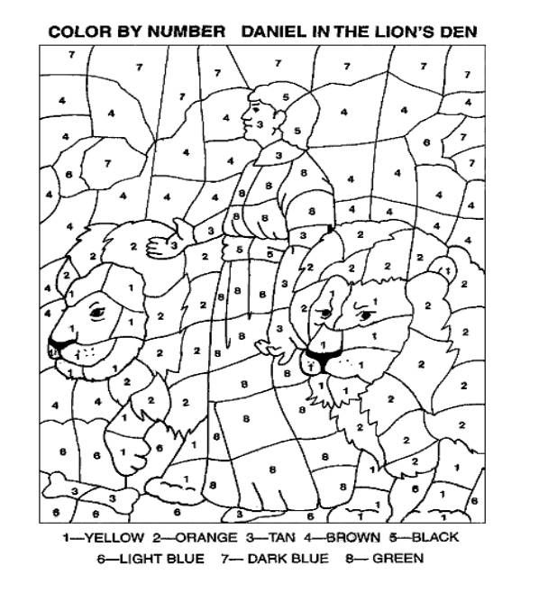
Can you make a lions face using
dried pasta spirals?

Slide 4

Something to watch:
Watch the Superbook characters today in the story of Daniel and the lions
https://www.youtube.com/watch?v=5UNBtaVsWm4&t=534s
Something to make:
A Lion Mask.
Colour in the picture, cut round the edge, Carefully cut out the eyes. Punch
The holes on each side of the lions head and thread through some elastic or
string

